Slide 1
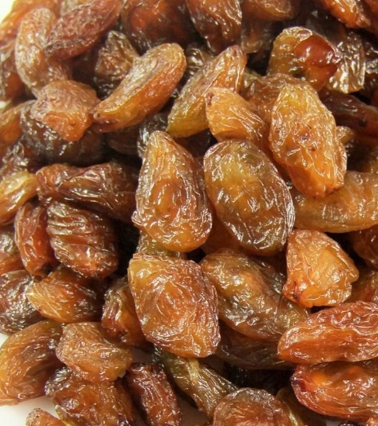



Gebze Technical University
Department of Computer Engineering
CSE 557
Data Mining
Fall 2023
Lecturer
Prepared by
Dr. Burcu Yılmaz
Bülent Karadeniz
Project Presentation
Comparison of Machine Learning Models such as Logistic Regression, SVC, DT, RF
in the Classification of Raisin Grains.
January / 2024

Slide 2
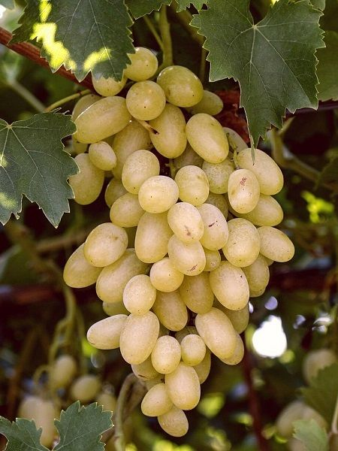
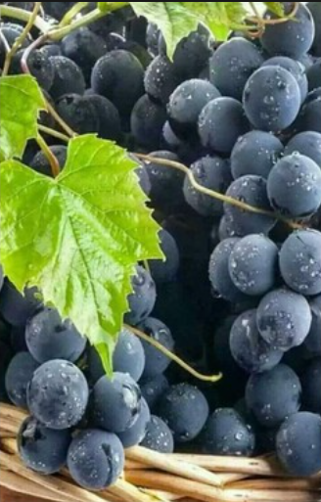
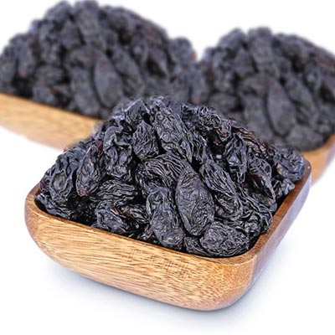
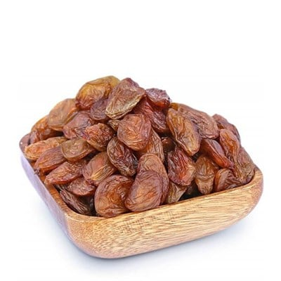
Outline
Introduction and Objectives:
Dataset
Machine Learning Models
Model Performance Evaluations
Results & Model Comparison & Conclusion

Slide 3
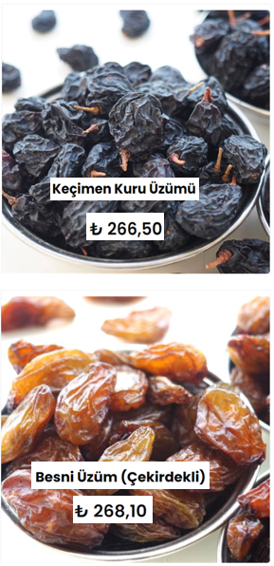
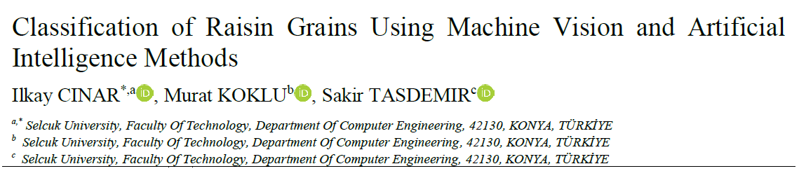
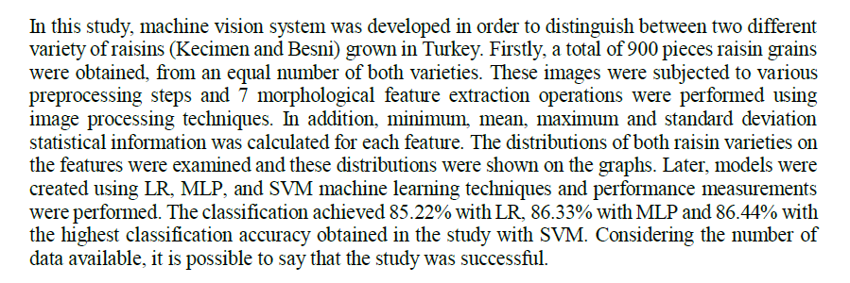
Introduction and Objectives

Slide 4
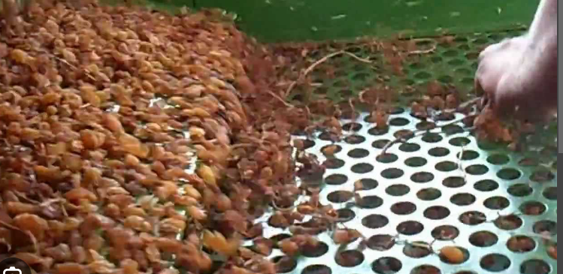
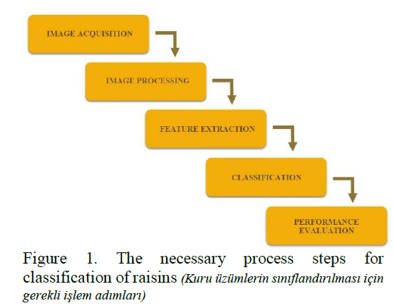
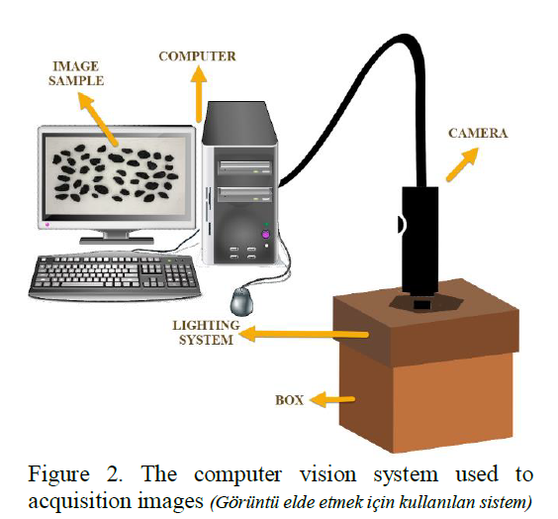
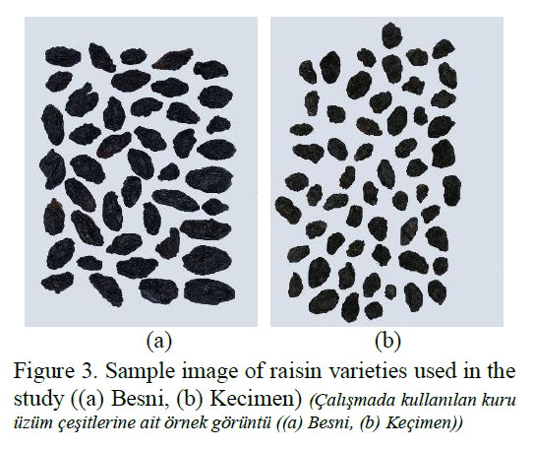
Introduction and Objectives
There are many applications of traditional methods for assessing and determining the quality of foods.
However, these can be time-consuming and expensive. In addition, human-made procedures from traditional methods can be inconsistent and more inefficient, as well as physical conditions such as fatigue and even people's psychological mood can affect the outcome of the work.
My aim is to test the machine learning used in the authors' study on the same data set and to observe different model results by trying different additional methods.

Slide 5
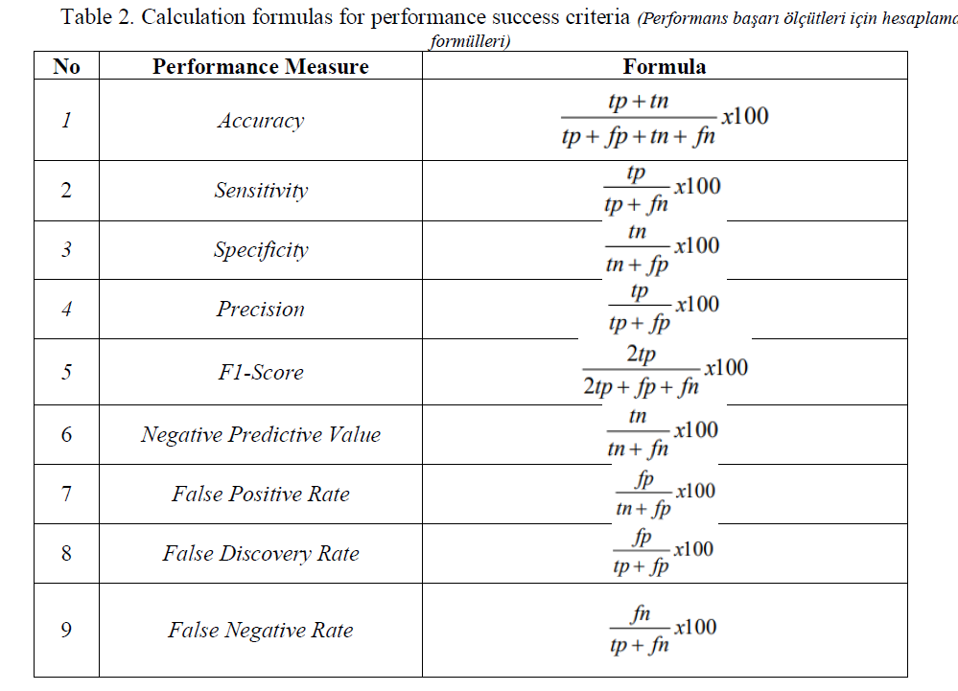
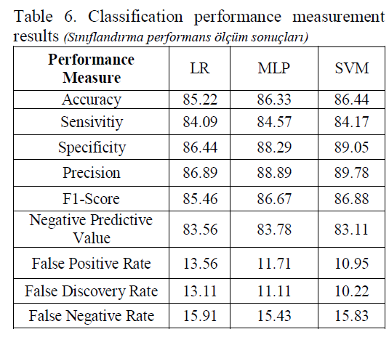
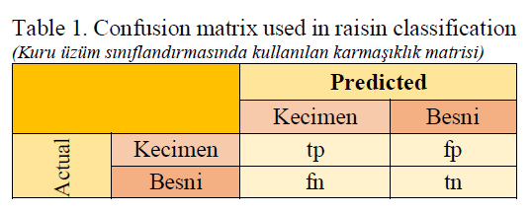
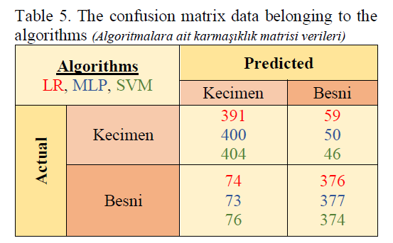
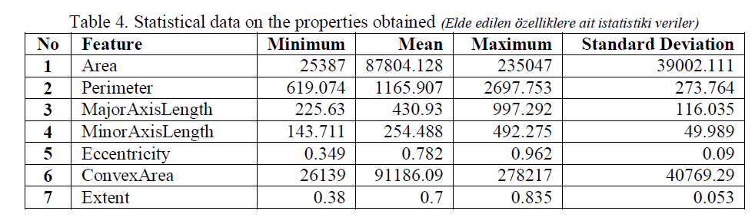
Introduction and Objectives

Slide 6
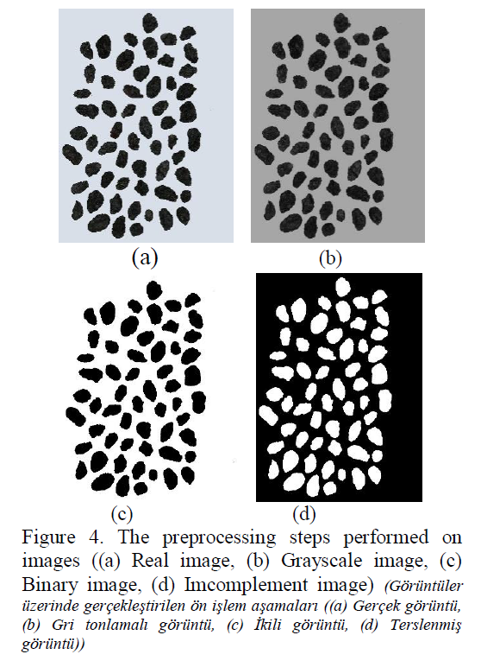
2. Dataset
A total of 900 images of raisins were obtained from both types of raisins used in the study, including 450 pieces.
Features
Area: Gives the number of pixels within the boundaries of the raisin grain.
Perimeter: It measures the environment by calculating the distance between the boundaries of the raisin grain and the pixels around it.
MajorAxisLength: Gives the length of the main axis, which is the longest line that can be drawn on the raisin grain.
MinorAxisLength: Gives the length of the small axis, which is the shortest line that can be drawn on the raisin grain.
Eccentricity: It gives a measure of the eccentricity of the ellipse, which has the same moments as raisins.
ConvexArea: Gives the number of pixels of the smallest convex shell of the region formed by the raisin grain.
Extent: Gives the ratio of the region formed by the raisin grain to the total pixels in the bounding box.

Slide 7
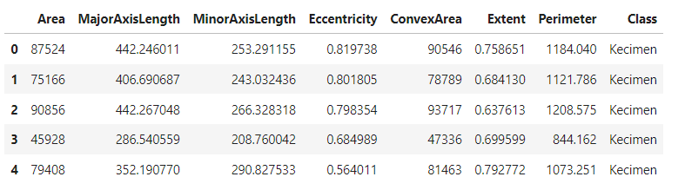
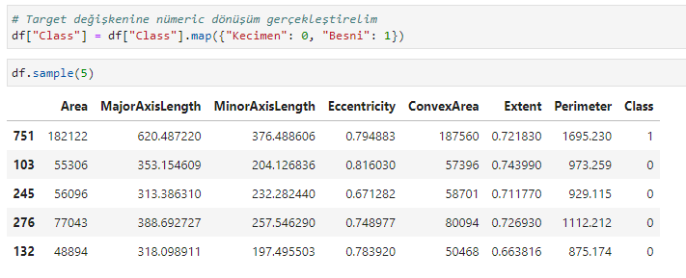
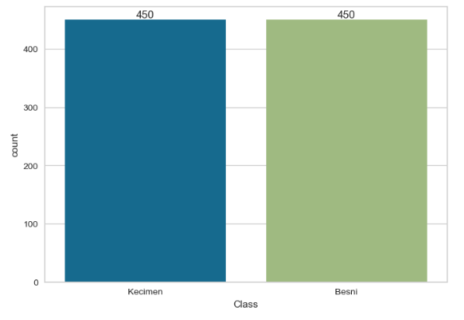
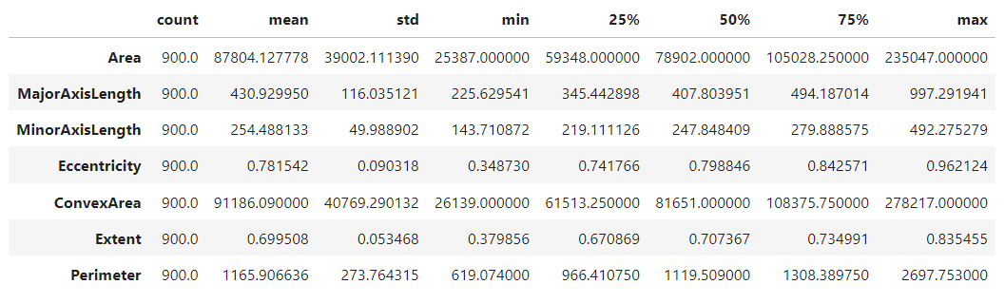
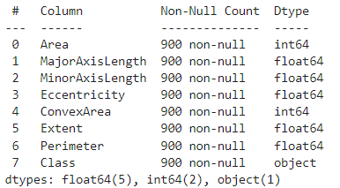
2. Dataset

Slide 8
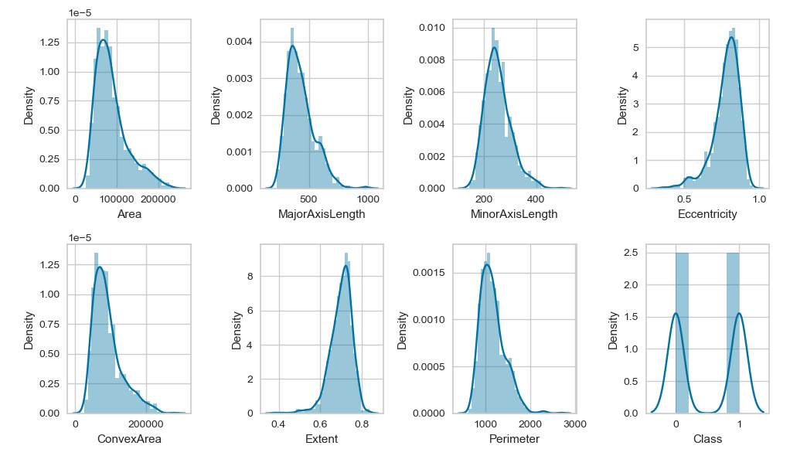
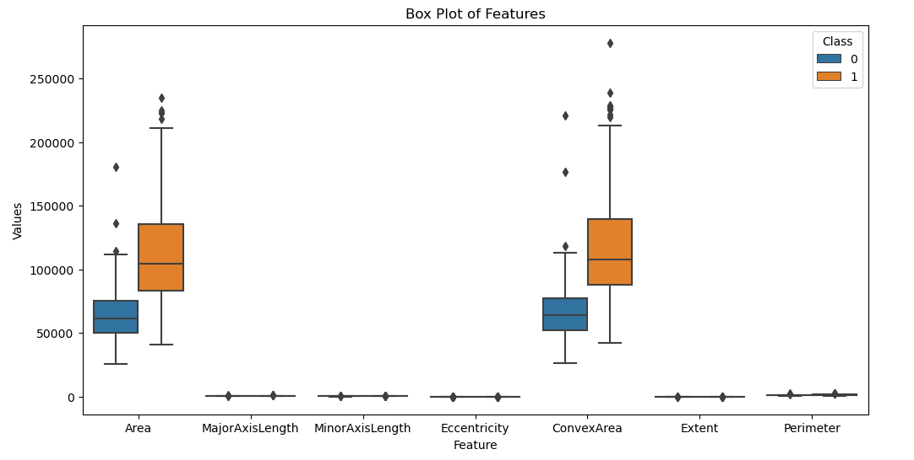
2. Dataset

Slide 9
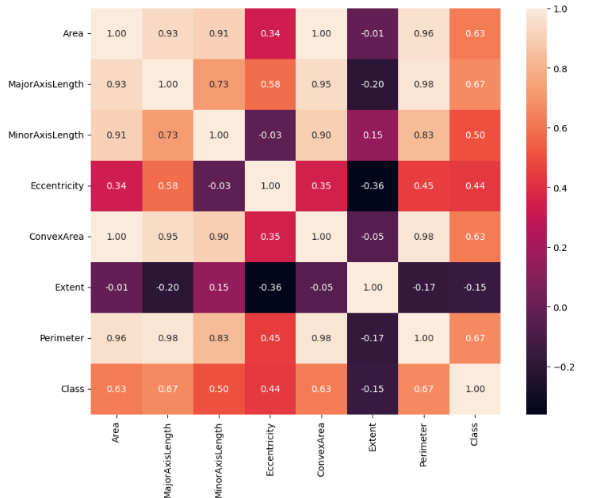
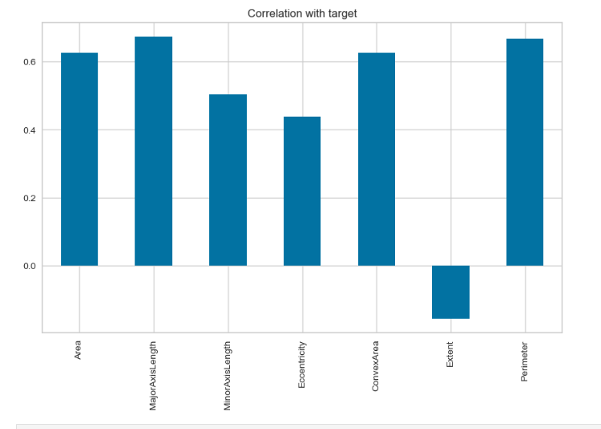
2. Dataset

Slide 10
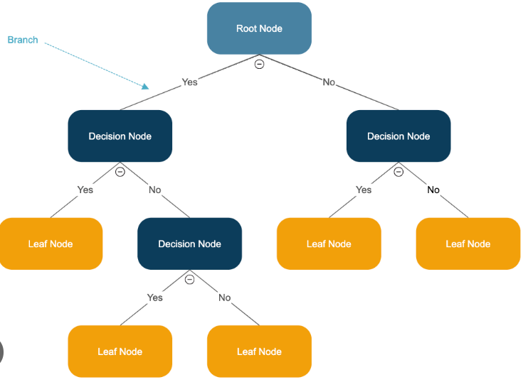
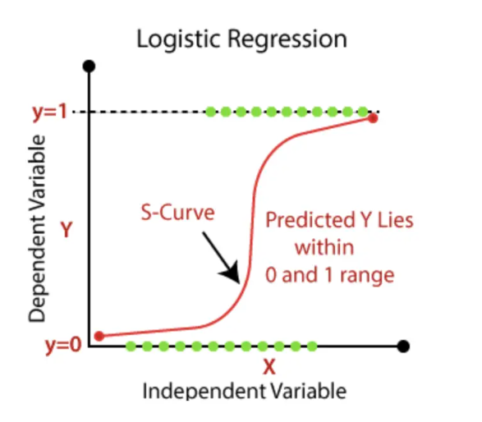
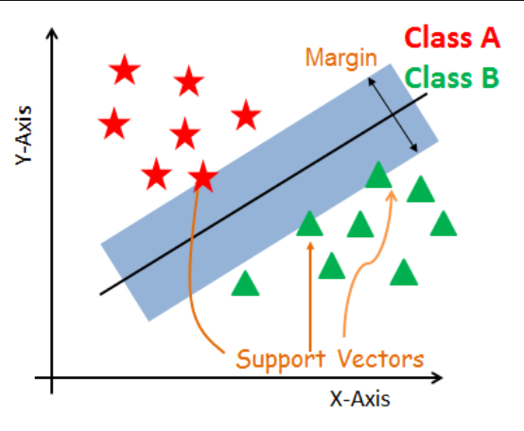
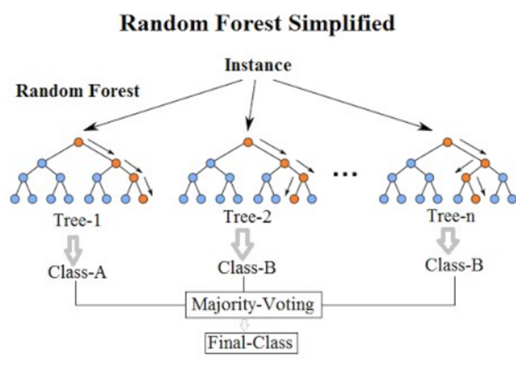
3. Machine Learning Models
Logistic regression
Support Vector Machine
Decision Tree
Random Forest

Slide 11
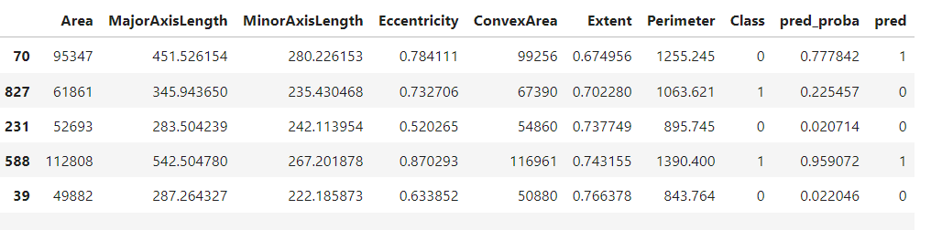
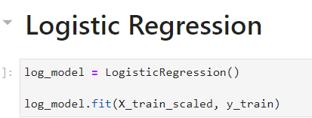
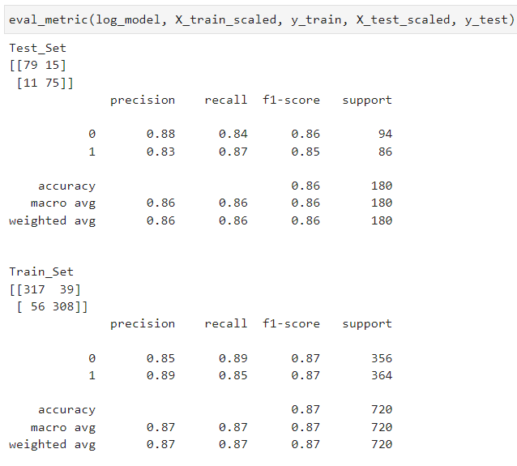
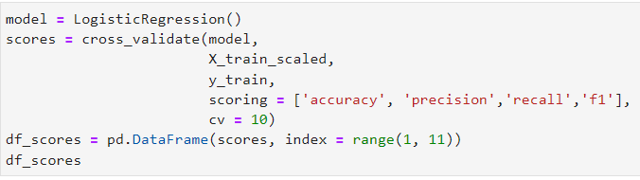
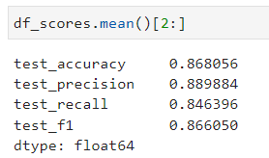
4. Model & Performance Evaluations

Slide 12
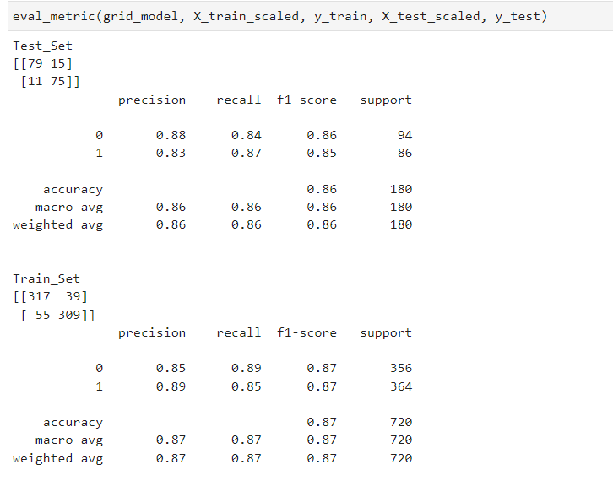
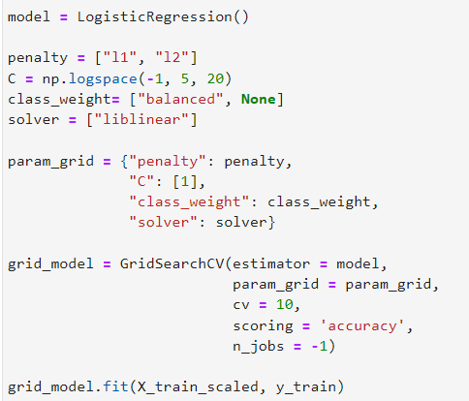
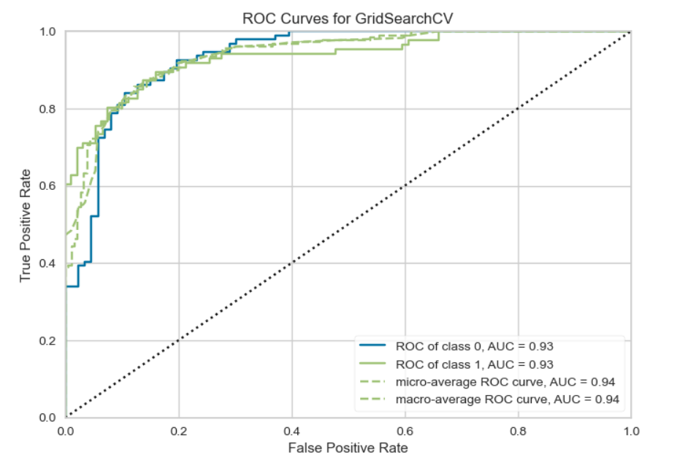
4. Model & Performance Evaluations

Slide 13
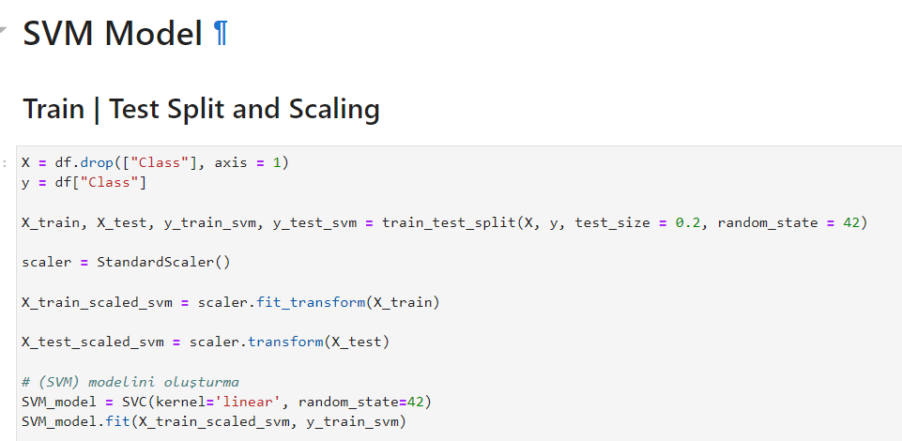
4. Model & Performance Evaluations

Slide 14
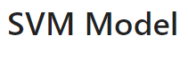
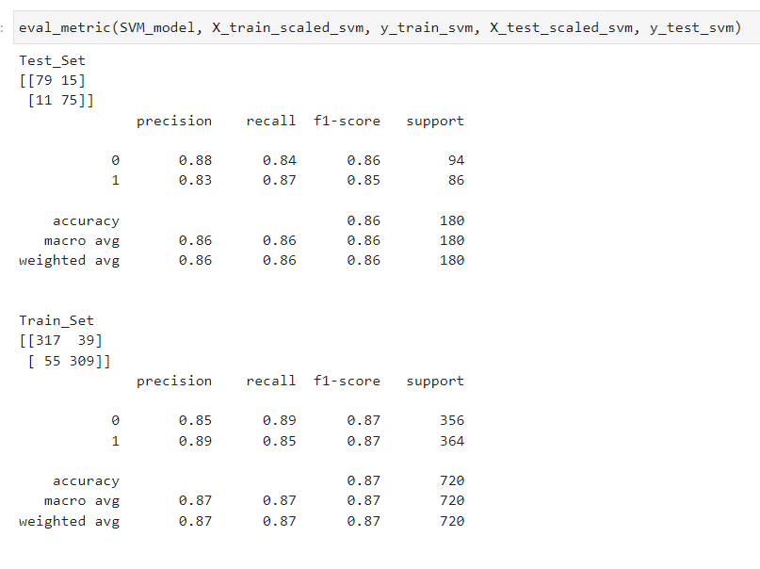
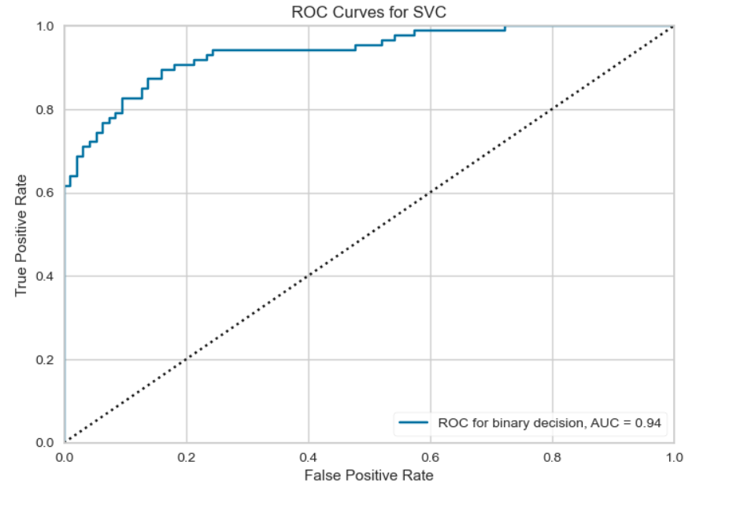
4. Model Performance Evaluations

Slide 15
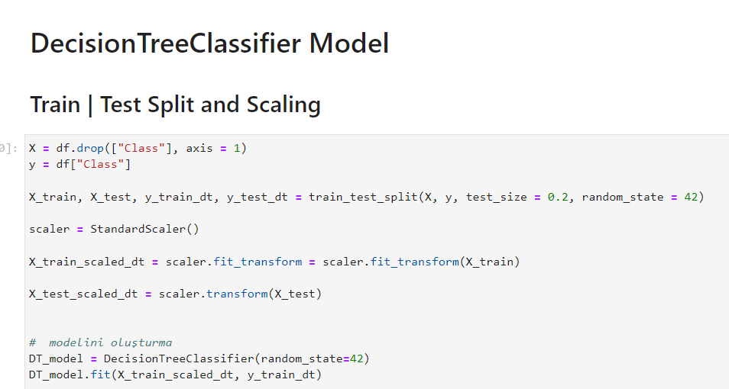
4. Model & Performance Evaluations

Slide 16
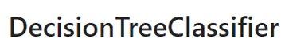
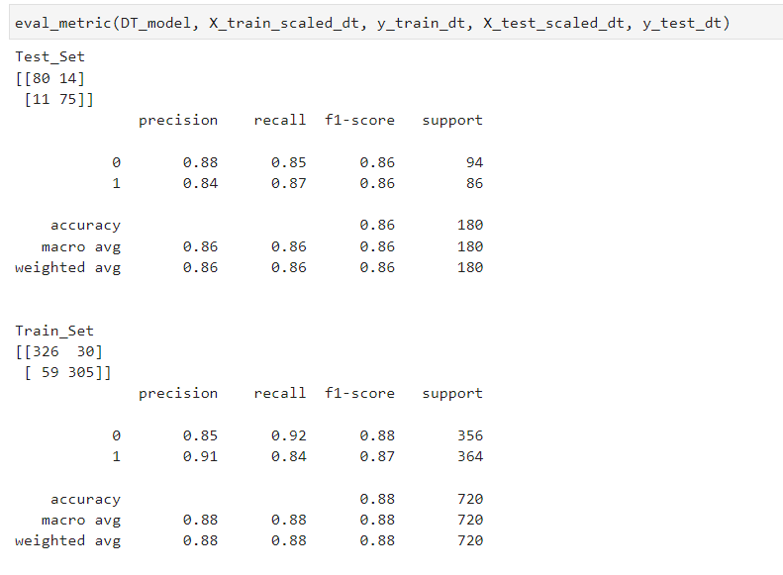
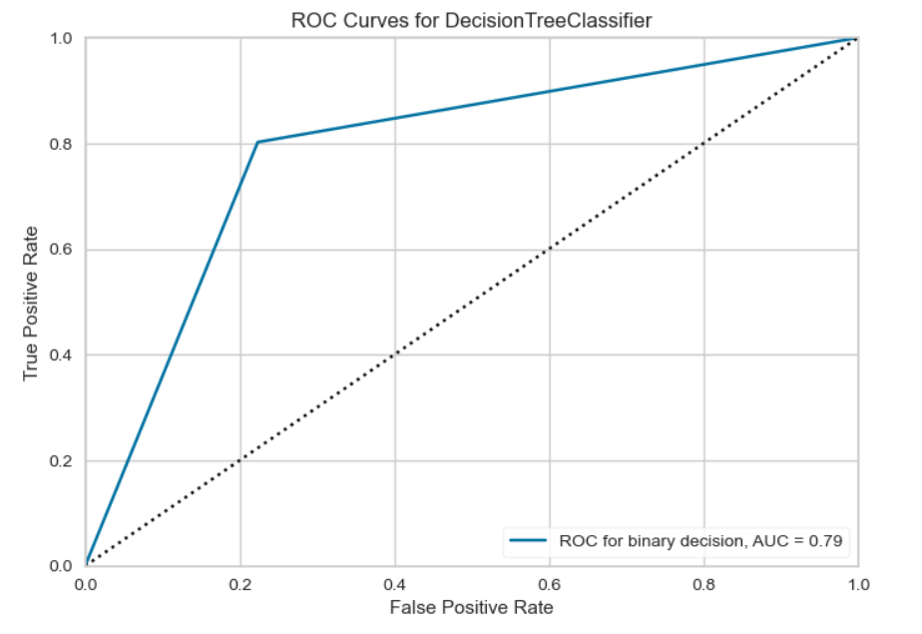
4. Model & Performance Evaluations

Slide 17
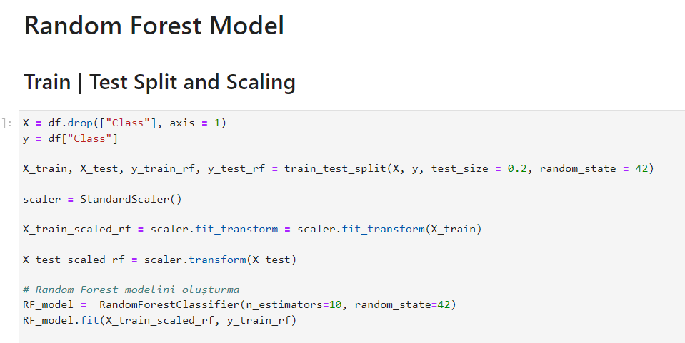
4. Model & Performance Evaluations

Slide 18
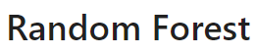

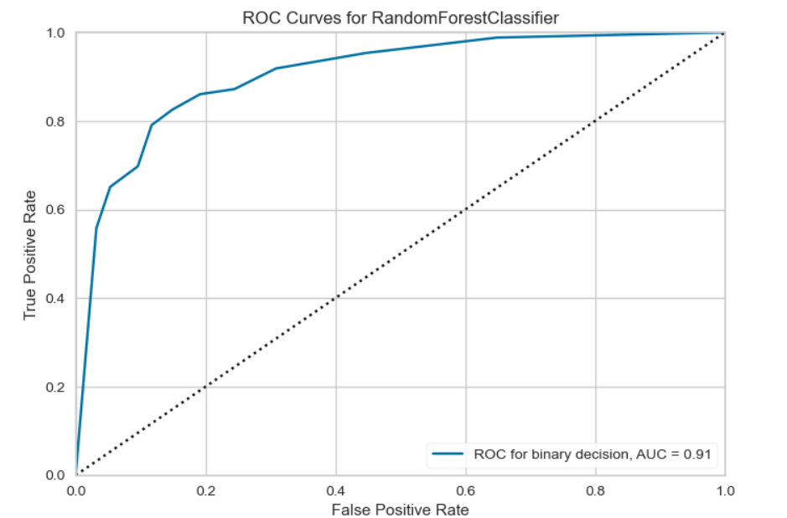
4. Model & Performance Evaluations

Slide 19

5. Results & Model Comparison & Conclusion

Slide 20

Thanks

